Slide 1


Life expectancy Prediction OR568: FINAL PROJECT PRESENTATION PROF. RAN JI
DEEPTHI TAMMA
SAATHVIKA KOMMISETTY
KEERTHI GOLLAMUDI
CHAITANYA SADASIVUNI
SAI ATCHUTH REDDY SYAMALA

Slide 2









THE dataset
Life expectancy dataset
Data source
How old is the data
Number of variables
Factor influencing life expectancy
Demographic variables
Immunization and human development index
Income composition variables
Mortality rates
Social factors

Slide 3

LIFE Expectancy dataset
We have retrieved this dataset from Kaggle , health data originally collected from World health organization and the economic data from United Nations website.
This data-set consists of the information on life expectancy and the health factors that affect this life expectancy rate for 193 countries for the years between 2000 and 2015.
The models which we performed on this dataset predict the life expectancy considering the attributes/ variables.

Slide 4
Factor influencing life expectancy
The data set contains different attributes such as Life expectancy which we considered as target variable, Demographic variables, Income composition variables, Mortality rates, and Immunization and human development indexes.
There are couple of variables in each set as follows: Demographic variables: Country Immunization and human development index: Hepatitis B, Polio, Diphtheria, Measles, BMI, thinness 1-19 years, thinness 5-9 years Income composition: Percentage expenditure, Total expenditure, GDP, Income composition of resources Mortality rates: deaths under age 5, infant deaths, adult mortality, HIV/AIDS Social factors: Developing status of the individual countries, Schooling Other variables: Year, Alcohol, Population

Slide 5

Data preprocessing
How we handled the missing data and NA?
As soon as we loaded the data, our primary task was to check if there are NA values and other missing data.
We performed imputation on the raw dataset (which has 2563 missing values) before jumping into the modeling techniques. The imputation has been done in R studio.
The imputation involved the process of replacing all the NA and missing values with Mean or central tendencies generated from the values of that particular column.
The variables which are found to have abnormal distributions had to go through data repair or data cleaning procedures/ outlier treatment (removing NULL values, avoiding NA values).This is also called as date wrangling.

Slide 6

correlation analysis & PCA
The data cleaning process is followed by the correlation analysis and the principal component analysis methods. This process is done in python (Jupyter notebook).
The correlation analysis determines how strongly or weakly the variables are related to the other variables in the dataset. We check the correlation between all the independent variables with the target variable. We also used the heatmap to visualize the level of correlation which will be explained in detail in the later slides.
After checking the correlation between the variables, few variables such as deaths under age 5, infant deaths, thinness 1-19 years, thinness 5-9 years, GDP, Percentage expenditure have been dropped as they distort our analysis by having correlation greater than 0.9 which is to be considered as a problem of Multicollinearity.

Slide 7
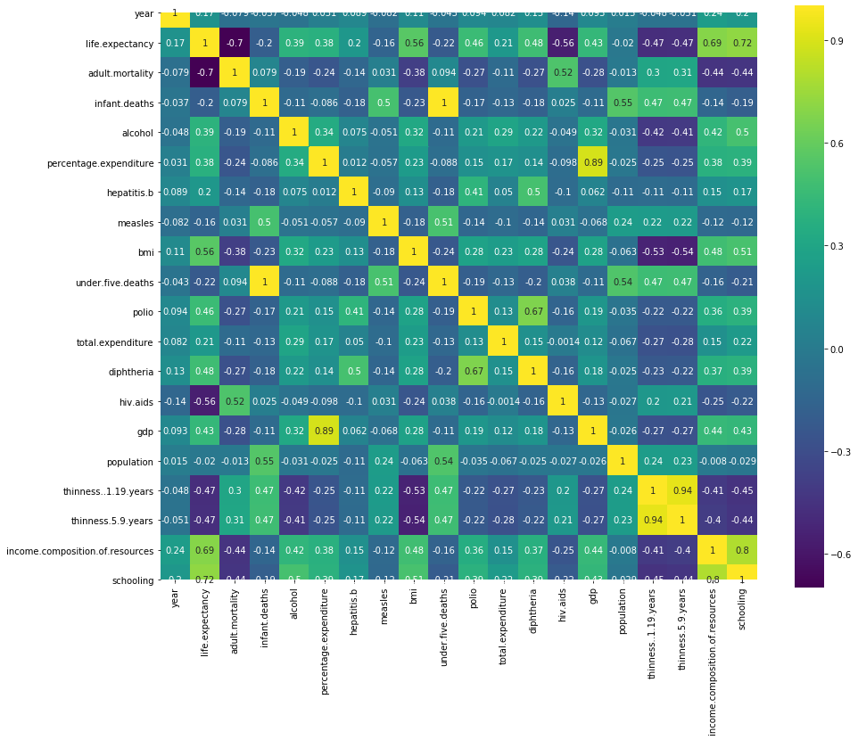
Heat map

Slide 8
Principal component analysis
Then, Principal component analysis (PCA) is performed. The main purpose of PCA is to find out the smaller number of numerical variables that contains most of the data.
Principal Component Analysis (PCA) is used to explain the variance-covariance structure of a set of variables through linear combinations. It is often used as a dimensionality-reduction technique.

Slide 9
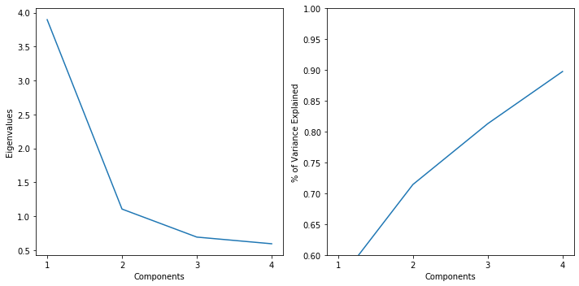
Scree plot

Slide 10
Predictive models
We have performed 6 predictive models on the dataset to know what factors (variables) influence the life expectancy the most.
We made use of the following predictive models and the outcomes such as mean squared error and R squared value which help us in determining the accuracy of the prediction each model will be individually reported when we move to the next slides.
Predictive models
Multiple linear regression
Lasso regression
Ridge regression
Decision tree
Random Forest
Gradient boosting method

Slide 11
Multiple Linear regression
As we have many independent variables that may majorly affect the life expectancy rate in various countries, we have considered to perform multiple linear regression
The dataset is divided into training and test sets in the ratio of 70% and 30% respectively.
The model is trained using the training set and further used in predicting the values of test set.
The metrics which we have considered in determining the performance of the model are MSE and R2_score.
The MSE=4.22% and R2_score=80.28% are obtained for this model.

Slide 12
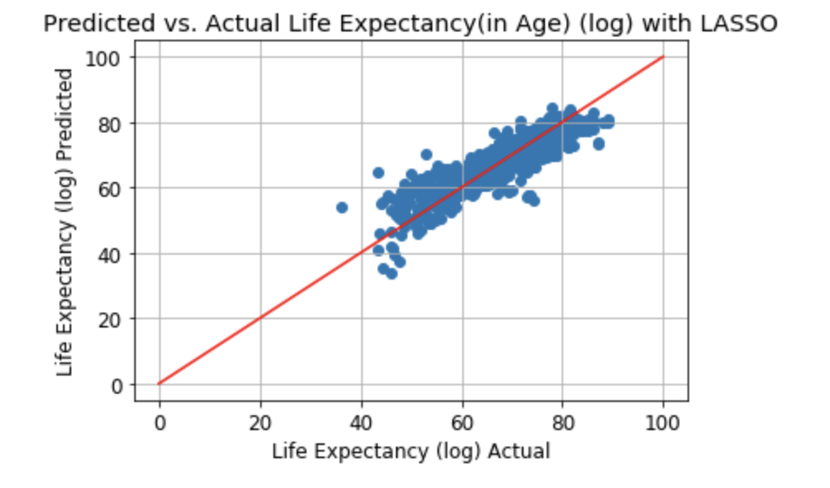
Lasso Regression
Predicted the Life expectancy (in age) which is a continuous variable depending on various factors.
Broke the dataset into train set and test set with 70% and 30% ratio respectively with a default alpha value as 1
With alpha=1, MSE =19.24, R2_score =79.41
To get the best alpha value, tuned the parameter using the gridsearchCV class with a grid of values we have defined.
Now, alpha=0.02 (best value), MSE=18.36, R2_score =80.35

Slide 13
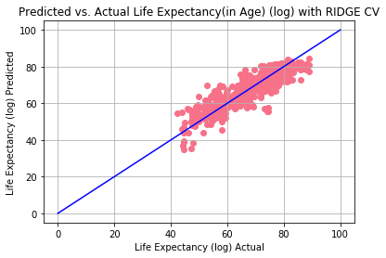
Ridge regression
Predicted the Life expectancy (in age) which is a continuous variable depending on various factors.
Broke the dataset into train set and test set with 70% and 30% ratio respectively with a default alpha value as 0.01
With alpha=0.01, MSE =18.52, R2_score =78.14 To get the best alpha value, tuned the parameter using the gridsearchCV class with a grid of values we have defined.
Now, alpha=0.06 (best value), MSE=18.51, R2_score =78.15

Slide 14
Decision trees
The predicted outcome is a continuous variable, so used regression tree analysis.
Used hyper parameter tuning for getting the best parameters for building the ideal decision tree. Also, used GridSearchCV for hyper parameter tuning.
The parameters considered are min_samples_split, max_depth, max_leaf_nodes
The best parameters values are max_depth = 10, max_leaf_nodes = 130, min_samples_split = 10
MSE = 6.39, R2_score = 92.6 (metrics after using hyper parameter tuning)
HIV.AIDS, Adult.Mortality, Income.composition.of.resources, Schooling, and BMI are considered to be the 5 top important variables for this model.

Slide 15
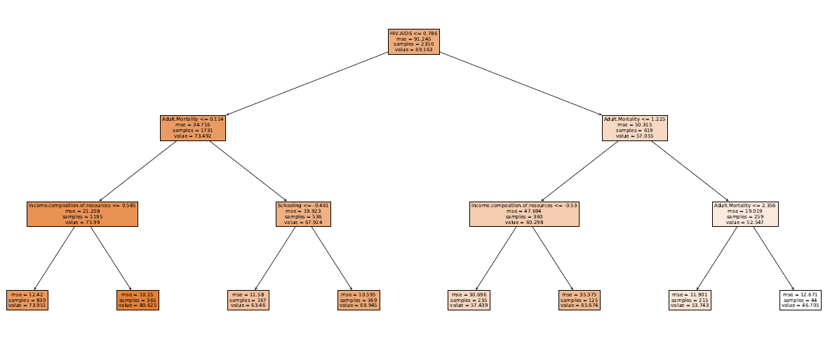
Decision Tree with Max_Depth=3

Slide 16
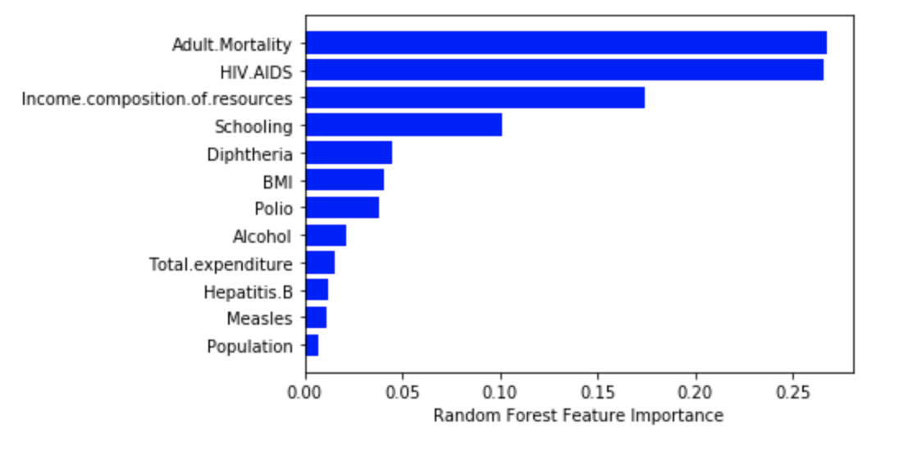
Random Forest Regression
The parameters max_depth, n_estimators, max_features, min_samples_split, min_samples_leaf, and bootstrap are used.
Using the gridsearch for hyperparameter tuning, the best values for the above parameters are max_depth=30, n_estimators=30, max_features=‘sqrt’, min_samples_split=2, min_samples_leaf=1 and bootstrap=False.
After hyperparameter tuning MSE=4.09, R2_score=95.17
From the plot, we can see that the feature importance for the Random forest and the top 5 attributes are Adult.Mortaility, HIV.AIDS, Income.composition.of.resources, Schooling, Diphtheria.

Slide 17
GRADIENT BOOSTING METHOD
The parameters max_depth, n_estimators, max_features, min_samples_split, min_samples_leaf, and learning rate are used.
Using the gridsearch for hyperparameter tuning, the best values for the above parameters are max_depth=7, n_estimators=30, max_features=‘auto’, min_samples_split=2, min_samples_leaf=5 and learning rate=0.15
After hyperparameter tuning, the values of MSE=3.6530683676056674, and R2_score=96.09093291528339
The top 5 important variables are HIV.AIDS, Adult.Mortality, Income.composition.of.resources, Schooling, and BMI

Slide 18
problem statement - 1
Does the life expectancy affected by different forecasting variables that were originally chosen? What are the predictive factors that are currently impacting life expectancy? Yes, definitely. There are 21 variables in the dataset apart from the target variable. Through correlation analysis, we have filtered out the variables that are less significant on the models, and that impacted achieving accuracy for the target variable. The predictive factors that are currently impacting life expectancy as per our analysis are Hepatitis B, Polio, Diphtheria, Measles, BMI, Total expenditure, Income composition, Adult mortality, HIV/AIDS, Developing status of the individual countries, Schooling, Year, Alcohol, Population.

Slide 19
problem statement - 2
Are the child and adult mortality rates influencing life expectancy? If yes, how? Through the correlation analysis, it has been observed that the child mortality hasn’t influenced much in predicting the life expectancy, but the principal component analysis has proved that the adult mortality rates show the highest influence on the life expectancy. We support our statement by checking the Eigen values that are greater than 1 and looking at the elbow in the scree plot. The PCA has returned us that only 2 principal components which explain 71.42% of the variance in our data.

Slide 20
problem statement - 3
What kind of correlation does life expectancy have with the predictors such as eating habits, lifestyle, exercise, smoking, drinking alcohol etc. In this process of analysis, we have double-checked the correlation values with the scatter plots and concluded that most of the predictors have a high correlation. Alcohol – 0.39 (low correlation) BMI – 0.56 (high correlation) Income composition – 0.69 (high correlation) Schooling – 0.72 (high correlation)

Slide 21
problem statement - 4
Does education (schooling) of an individual impact the lifespan of humans in any way? As already discussed in the previous slide, the correlation coefficient of the variable schooling on the life expectancy is 0.72 which means that both the variables are almost in a perfect positive correlation and move in the same direction together. We conclude that education has an impact on the target variable.

Slide 22
problem statement – 5&6
Is there a positive or negative correlation between life expectancy and consumption of alcohol? The alcohol consumption has a positive correlation coefficient with the target variable but it is a low correlation as the values are close to 0 which means that there is a weak or no linear relationship.
What are the effects of immunization coverage life expectancy? The variables polio and diphtheria fall under the immunizations along with measles and Hepatitis-B where the correlation coefficient for the attributes polio and diphtheria have a better effects on the life expectancy. They both have a positive correlation around 0.4.

Slide 23
Conclusion
After performing all the models, it is found out that the model that gives us the best accuracy in predicting the life expectancy with the factors influencing it is Gradient boosting method with an accuracy (R2_score) of 96.1% and the lowest error (mean squared error) of 3.65%.
For better understanding purpose, the scores for all the models are consolidated as follows:
Model name | MSE | R2 Score
Multiple linear regression | 4.216255411174891 | 80.2770669546718
Lasso regression | 18.362505487024663 | 80.35069192003564
Ridge regression | 18.516447591318254 | 78.14673558994411
Decision tree | 6.397887956732298 | 92.62650908451462
Random forest | 4.094849199085256 | 95.16722514804292
Gradient boosting method | 3.6530683676056674 | 96.09093291528339

Slide 24


THANK YOU

